Slide 1
LITERATURE SURVEY
Year | Title | Source | Finding
2013 | Research and reviews in question answering system | International Conference on Computational Intelligence: Modeling Techniques and Applications(https://www.sciencedirect.com/#open-access) | We observed that the choice of a technique is highly problem specific. Often a hybrid approach, judiciously blending apparently different techniques, provides improved results in the form of faster speed, increased relevancy, and higher precision and recall measures. It is, however, realized that question answering techniques, based on linguistic approach, statistical approach and pattern based approach will continue to remain in sharp focus, receiving attention of a large number of Question Answering System researchers.
May 2018 | Implementation of a Chatbot System using AI and NLP A College chatbot | International Journal of Innovative Research in Computer Science & Technology (IJIRCST) ISSN: 2347-5552, Volume-6, Issue-3, May 2018 | The college chatbot aims to remove this difficulty by providing a common and user-friendly interface to solve queries of college students and teachers. The purpose of a chatbot system is to simulate a human conversation. Its architecture integrates a language model and computational algorithm to emulate information online communication between a human and a computer using natural language. Instead of AIML based bot, other algorithms can be implemented. We can include voice-based queries. The users will have to give voice input and the system will give the text output.
6/08/2018 | International Journal of Engineering and Technology(UAE) | A literature survey on question answering system in Natural Language Processing | It was based on Q&A techniques available. It is however, realized that question answering techniques, based on linguistic approach are faster and helps in user based friendly interaction.
12/01/2016 | The Question Answering System Using NLP and AI | International Journal of Scientific & Engineering Research Volume 7, Issue 12 | This paper describe about the Question Answering System for an English Language i.e. it receives query from the user and selects most appropriate answer. QAS is approach to find the correct answer to the question asked from user. This paper also describes different QAS approaches, different types of QAS.QA system help in improving system interaction. In this paper we also concentrated on finding the solution of some problem: Answer is restricted to a precise domain, user has to follow a particular path while entering a question and Extracting correct answer. The solution consists: semantic representation for Natural Language, effective logic is to be performed on them and developing a formalism to represent the answer verification and specific answer extraction. Thus there is great potential for exploring the challenges in QA domain.
11 June /2021 | A Review on Medical Textual Question Answering Systems Based on Deep Learning Approaches | {https://www.mdpi.com/2076-3417/11/12/5456} An Open source Review | Medical QA has made significant progress in recent years due to the use of deep learning techniques in this area. Automatic QA has been possible in many medical question–answering systems, and the availability of corpus data in the medical domain is increasing over time. In this paper, we provided an extensive review of the prominent works on deep-learning-based medical textual QA. The study started with an overview of QAS and provided a brief outline of the tasks, types, and the representative of medical QAS.
December 2018 | QUESTION ANSWERING SYSTEMS: ANALYSIS AND SURVEY | International Journal of Computer Science & Engineering Survey (IJCSES) Vol.9 | In this survey paper are show an overview on what Question-Answering is and its architecture and how can be used as intermediate semantic representations of vague expressions. we pin down the previous related research with summarized and organized recent research results in a novel way that integrated and added understanding to work in the question-answering field. It emphasized the classification of the existing literature, developing a perspective on the area, and evaluating trends. However, because it is impossible for a survey to include all or even most of previous research, this survey included only the work of the top-publishing and top-cited authors in the QA field.
2018 | Academic Reader: An Interactive Question Answering System on Academic Literatures | The Thirty-Third AAAI Conference on Artificial Intelligence (AAAI-19) Shanghai Jiao Tong University | We propose a question answering system called Academic Reader, which massively provides answers to questions concerning the specific academic literature. It assists researchers in browsing through, filtering and sorting papers on their demands. As future work, we plan to expand our paper reading task from the domain of computer science to other domains like mathematics, physics, etc. Moreover, we will optimize our model by integrating the external knowledge in certain fields with context entities.

Slide 2
Analysis And Improvement
The above survey analysis helped me to get the major point for the Q&A system requirement and how can i improve it.
Using of pattern based approach can help the implementation be fast and Result are more accurate.
Instead of AIML based bot I can also use another approach .
Voice input system can be a huge advantage in Q&A system if possible.
More filtering and sorting of data can help a lot as it can reduce the searching of the Question .

Slide 3
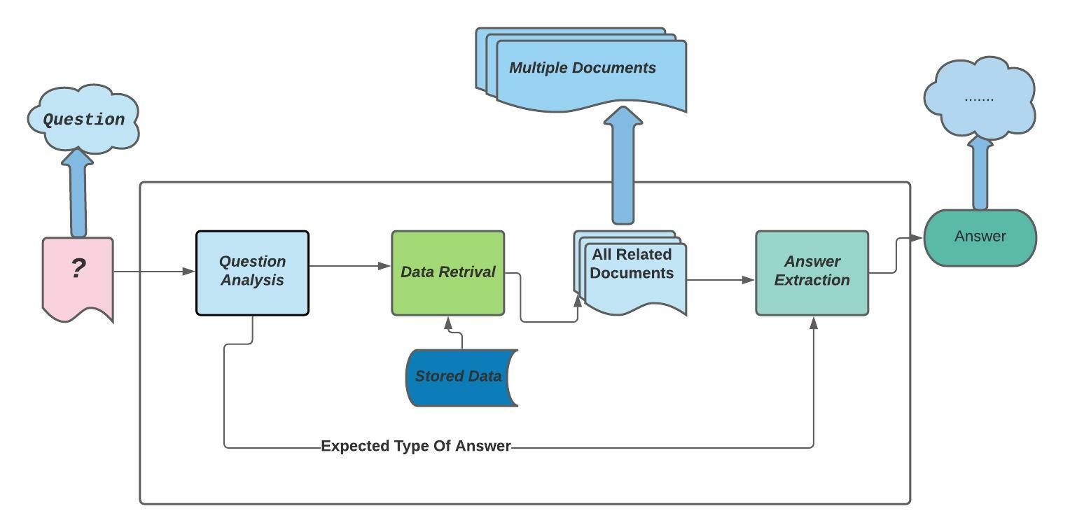
Architecture Diagram

Slide 4
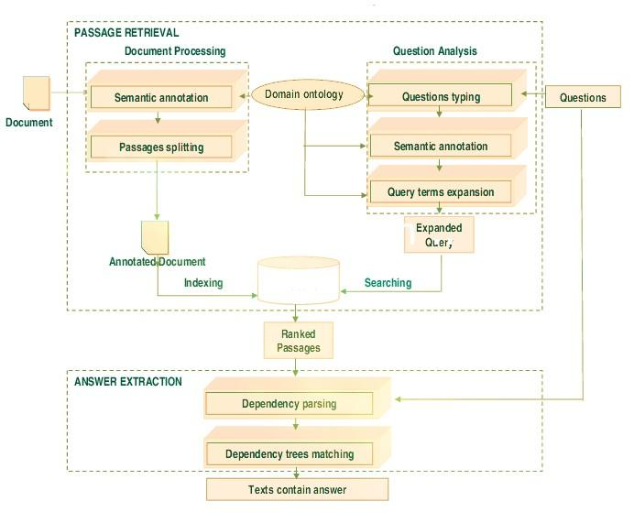

Slide 5
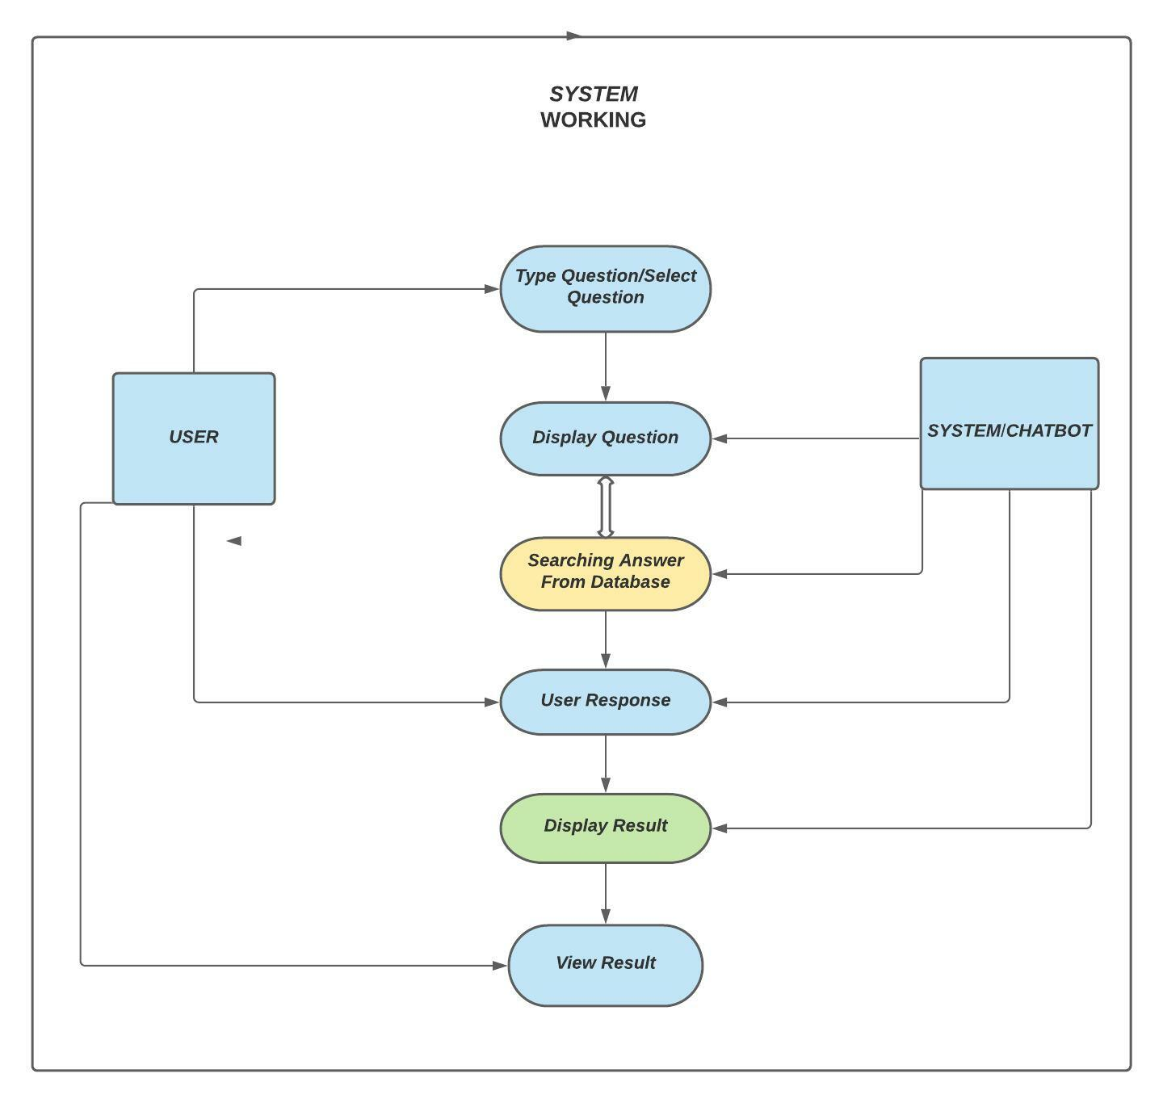
Use Case Diagram

Slide 6
Project Dairy
Date | Queries/Interaction with Guide
Sep 26 | Asking about what we have to do for Upcoming Review
Oct .3 | How to Prepare for Literature Survey. Points to Focus On
Oct 10 | Architecture Diagram And UML diagram preparation and help needed for them
Oct. 16 | Final PPt and if changes are needed to be made.

